Slide 1
Engineering Chemistry Syllabus Continuous Evaluation: 70M, End Examination/s:30M
PREAMBLE
This course enables the students to gain knowledge on various aspects of Water and its treatment, electrochemical energy systems, Construction of batteries, renewable energy sources, Semiconductors, Steel, Cement and Polymers, Corrosion and its control, nano-materials, Analytical instruments and applications. The knowledge gained in this course can be applied to the latest developments in technology.
COURSE OBJECTIVES
To impart knowledge on various aspects of water and its treatment.
To study about electrochemical energy systems, renewable energy sources, solar cells and their applications.
To gain knowledge on materials such as steel, cement and polymers
To create awareness on corrosion and its control.
To introduce different types of nano-materials.
To expose the students to latest instrumental techniques such as
scanning electronic microscope (SEM) & transmission electron microscope (TEM).

Slide 2
UNIT- I WATER TECHNOLOGY
Water and its treatment: Introduction – hardness of water – Causes of hardness - Types of hardness: temporary and permanent – expression and units of hardness. Estimation of hardness of water by complexometric method. Potable water and its specifications. Steps involved in treatment of water – Disinfection of water by chlorination and ozonization- industrial water treatment- Boiler feed water and its treatment -internal conditioning– Calgon and Phosphate conditioning. External treatment of water – Ion

Slide 3
UNIT- II ELECTROCHEMICAL ENERGY SYSTEMS
Basic concepts, battery characteristics, classification of batteries, Important applications of batteries,
Classical batteries-dry/Leclanche cell, Modern batteries-zinc air, Lead-acid storage battery, lithium cells- Lithium ion cell, Li MnO2 cell. Fuel cells- Introduction - classification of fuel cells – hydrogen and oxygen fuel cell, propane and oxygen fuel cell- Merits of fuel cell.
Renewable energy sources–Types of renewable energy sources,Semiconductors: Definition, types of semiconductors: doping- n type and p-type semiconductors and applications.
Solar cells: Introduction, harnessing solar energy, Photovoltaic cell, solar water heaters.

Slide 4
UNIT- III ENGINEERING MATERIALS AND POLYMER CHEMISTRY
Steel – Types of Steel, chemical composition – applications of alloy steels
Cement: Portland cement, constituents, Manufacture of Portland Cement, chemistry of setting and hardening of cement (hydration, hydrolysis, equations).
Polymer Chemistry: Concept of polymerization – Types of Polymerization, Chain growth polymerization– mechanisms of free radical and cationic polymerizations, Thermoplastic resins and Thermosetting resins: examples- Polyethylene, Styrene, Nylon 6,6 and Bakelite. and applications, Conducting polymers:– Examples –and applications.

Slide 5
UNIT- IV CORROSION AND CONTROL
Corrosion and Its Prevention: Electrochemical theory of corrosion, Corrosion due to dissimilar metal cells (galvanic cells), Corrosion due to differential aeration cells, Uniform corrosion, pitting corrosion and stress corrosion cracking, Effect of pH, temperature and dissolved oxygen on corrosion rate. Corrosion prevention and control by cathodic protection- protective coatings- paints.

Slide 6
UNIT- V NANOMATERIALS AND ANALYTICAL INSTRUMENTAL TECHNIQUES
Nano Materials: Introduction to Nano materials, chemical synthesis of nanomaterials: Sol-gel method, Reverse micellar method, electrolytic method, Characterization of nanoparticles by BET method, characterization of nanomateirals by TEM (includes basic principle of TEM), Applications of nanomaterials in waste water treatment, lubricants and engines.
Smart Materials: Introduction – Types of smart materials-self healing materials-Shape-memory alloys, and Uses of smart materials.

Slide 7
UNIT-I Water Technology
Introduction: Water is critical to the survival of the living organism and is second only to oxygen in importance for human survival.
Human body made up of 60-70% of water.
Transport of food and oxygen to the cells
Carry away to the waste
I is the fluid in which digestion takes place
It acts as lubricants for the cells and tissues
It regulates the body temperature.
Its regulate acid-base neutralization.

Slide 8
Water Technology
Water also utilized for domestic, drinking, industrial and agricultural purposes.
Our aim is to concentrate on industrial purpose.
In industries water is used for making steam and acting as coolant.

Slide 9
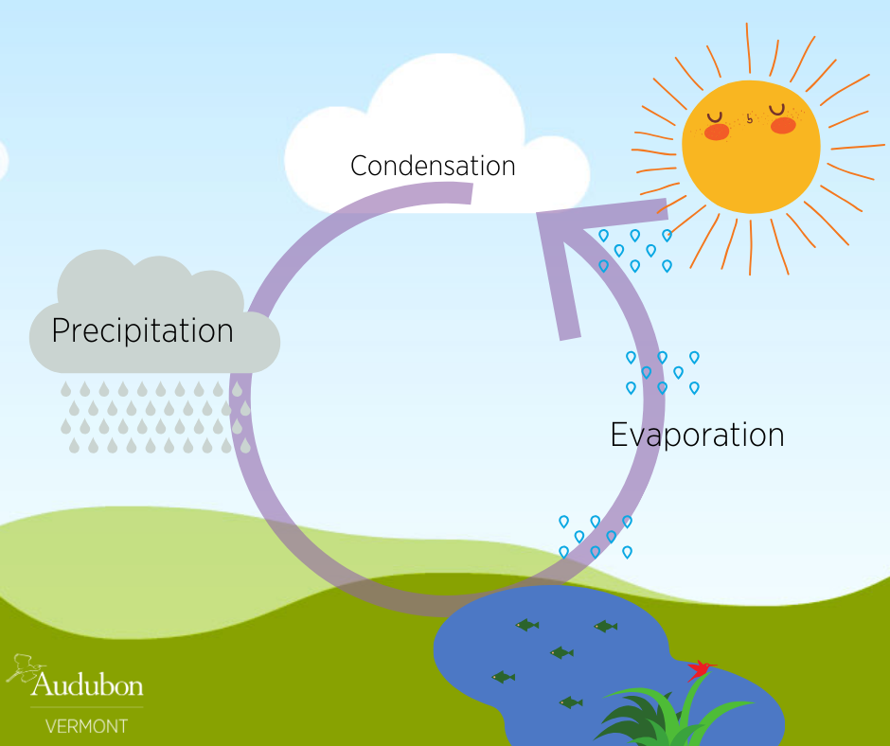
Water Technology
Sources of Water
Rain Water
Sea Water
River Water
Surface Water
Lake Water
Under ground Water

Slide 10
Water Technology
Various Impurities present in Water
Suspended Impurities:
Suspended Inorganic – clay, sand and stones
Suspended Organic - Biological
Suspended Colloidal – clay, sand, slit and mud
Dissolved Impurities:
Dissolved Inorganic – CaCl₂, MgSo₄ ..
Dissolved Organic –oils, fats and protein
Dissolved Gases – H₂S, CO₂ etc …
Bacteriological Impurities:
Macroscopic – fish
Microscopic – micro organisms
Bacteria & Virus – no seen with microscope

Slide 11
Water Technology
What ever may be the source of water, weather it is surface water or ground water it exist in two different forms
Soft Water: It is a sample of water which gives stable lather or foam when soap solution is added to.
Hard Water: It is a sample of water which gives unstable lather or foam when soap solution is added to. Instead of lather insoluble scum or ppt. is observed.
Hardness of Water
Hardness is the one of the characteristic property of the water, not giving lather immediately with soap. Hard water contains large amount of dissolved salts usually bicarbonates, carbonates, chlorides and sulphates of calcium and magnesium. Soft water also contains dissolved salts but the amount is less.

Slide 12
Water Technology
Why soap water does not give stable later with hard water?
Soap is an organic compound and it is sodium or potassium salt of higher fatty acid.
Soap may have the formula
C₁₇ H₃₅ COONa or C₁₇ H₃₅ COOK (sodium stearate or potassium stearate), C₁₇ H₃₃ COONa or C₁₇ H₃₃ COOK (sodium oleate or potassium oleate) and C₁₇ H₃₁ COONa or C₁₇ H₃₁ COOK (sodium palm mates or potassium palm mates) .
As such soap is highly soluble in soft water and forms lather immediately.
C₁₇ H₃₅ COONa + H₂O -------- C₁₇ H₃₅ COOH + NaOH
C₁₇ H₃5 DOOH + C₁₇ H₃₅ COONa ----------- Lather
But with hard water soap does not gave lather immediately and on the oyher hand, it forms insoluble white PPT. it because hard water contains large amount of dissolved salts like Ca & Mg salts. These metal ions react with soap and form corresponding insoluble metallic soaps.

Slide 13
Water Technology
For example if Ca Cl₂ is present in hard water, soap reacts it to form insoluble calcium soap, which appears as in the form of scum or ppt.
2( C₁₇ H₃₅ COONa) + ( C₁₇ H₃₅ COO)₂ Ca + 2NaCl
Similarly other dissolved salts are also react with soap and ppt. out. The reaction of soap with hard water continuous until all the DS are ppt. Out , formation o lather be gains because water becomes as good as soft water.

Slide 14
Water Technology
Types of Hard Water
Depending upon the nature of dissolved salts present in hard water, its hardness may be of two types (1) Temporary hardness (2) permanent hardness.
Temporary hardness: Temporary hardness is due to the presence of bicarbonates of calcium and magnesium salts. It can be removed by simple boiling of water.
Ca (HCO₃)₂ --------------- Ca CO₃ + H₂O + CO₂
Mg (HCO₃)₂ ------------- Mg CO₃ + H₂O + CO₂
(2) permanent hardness: Permanent hard of water is due the presence of chlorides and sulphates of calcium and magnesium salts. These salts can be removed by industrial water treatment methods.
(3) Total Hardness:
The sum of temporary and permanent hardness can be taken as total hardness of water.

Slide 15
Water Technology
Units of Hardness of Water
Hardness of water is presence of various dissolved salt (DS) present in water.
The hardness caused due to any dissolved salt is expressed in terms of calcium carbonate hardness.
Molecular weight of any DS is converted in to molecular weight of calcium carbonate .
Any DS present in water can be converted into calcium carbonate hardness by the following equation.
Mol. weight of Cal. Carbonate
Hardness of water due to the DS = weight of the DS X -----------------------------
Mol. Weight of DS
M. Weight of Ca Carbonate-100,
M. weigh of other salts
Ca Bicorbonate-162, Mg Bicarbonate -146,
Ca Sulphate-136, Mg Sulphate-120,
Ca Chloride-111, Mg Chloride-95.

Slide 16
Water Technology
For example: if a water sample contains 16.2 /kg of cal bicarbonate in 105 kg of water. Then it means 162 kg of cal bicarbonate is present in one million kgs of water.
100
now hardness of water = 162 X -------------
162
= 100 Kgs o Ca CO₃ per one million Kgs of water
= 100 parts of Ca CO₃ per one million parts of water
=100 ppm.
So the units of hardness of water is ppm. ( 1 part of Ca CO3 in one million parts of water).
also 1 ppm = 1 part per 106 parts of water.
= 1 mg per 106 mgs of water.
= 1 mg per I Kg of water.
= 1mg per 1 liter of water ( 1 Kg of water = 1 liter).
= 1 mg/l.
So the units of water is 1 ppm or 1mg/l.
Degree French: this is French unit of hardness of water. One degree French unit means 1 part of Ca CO₃ in 105 parts of water.
Degree British: this is British unit of hardness of water. One degree British unit means 1 part of Ca CO₃ in 70,000 parts of water.

Slide 17
Water Technology
Relation between different units of hardness of water
1ppm=1 mg/l = 0.07oCl = 0.1o fr
1 mg/l = 1ppm== 0.07oCl = 0.1o fr
10Cl =14.2 ppm = 14.2 mg/l = 1.42 fr
1ofr = 10 ppm =10 mg/l = 0.7oCl
Hardness of water problems
A water sample contains following DS , calculate temporary, permanent and total hardness of water.
Cal bicarbonate – 24 mg/l , Cal Chloride – 56 mg/l, Mg Chloride -32 mg/l.
Calculate the amount of temporary, permanent and total hardness of water sample from the following data. All values are in mg/l.
Cal bicarbonate- 8.1, Mg bicarbonate-2.4, Ca sulphate-5.6, Mg sulphate-6.2.
By using following data calculate temporary, permanent and total hardness of water. All values are in mg/l.
Cal bicarbonate- 8.1, Mg bicarbonate-14.6, Ca sulphate-13.6, Mg sulphate-12.0, Ca chloride-22.2, Mg chloride-9.5.

Slide 18
Water Technology
Determination of Hardness of an Under Ground Water Sample
Aim: Determination of the total hardness of the given sample of water by titrating
against a standard EDTA solution using Eriochrome Black- T as indicator.
Theory: Hardness present in a given sample of water can be determined by using the complex metric method, in which the disodium salt of EDTA is employed (soluble in water) and it can be represented as follows.
(EDTA – Ethylene Diamine Tetra Acetic acid)
HOOCH₂C CH₂COOH
N-CH₂ - CH₂ -N
NaOOCH₂C CH₂COONa
EDTA forms complexes with calcium and magnesium when the pH is in the range of around 9.5 to 10.5 and to maintain the pH, a basic buffer solution is used (NH₄OH + NH₄Cl buffer serves pH 9.5 to 10.5). The complexes of calcium and magnesium with EDTA are colourless, therefore it is necessary to use indicator to locate the end point. In this titration Eriochrome black – T is used as indicator, which forms an unstable wine red coloured complex with calcium and magnesium. Calcium ions complexed first with EDTA, but the colour change does not occur until all the magnesium has also completely reacted. It is thus possible to determine the total amount of these metals in the solution and the total hardness can be calculated. Calcium itself does not give a satisfactory end point with Eriochrome black – T indicator unless the solution also contains magnesium. When once all the calcium and magnesium ions are completely removed by EDTA,free indicator is left in the solution which imparts blue colour to the solution. So the colour change at the end point is wine red to blue.
M+2 + EBT -------------- M-EBT (complex)
no color blue wine red color
M-EBT (complex) + EDTA ------------ M-EDTA (complex) + EBT
wine red color no colo no color blue

Slide 19
Water Technology
Procedure: 50.0 ml of sample of hard water is pipetted out into a clean conical flask. To this 2 or 3 ml of ammonia - ammonium chloride buffer solution (pH 9.5 – 10.5) and 2 or 3 drops of Eriochrome Black – T indicator are added. (if necessary 2 drops of 0.1M – Mg – EDTA complex is added in order to get the clear end point). The burette is filled with 0.01 M EDTA solution, after rinsing with same and the initial reading is noted. Now the contents are titrated with EDTA solution until the colour hanges from wine red to blue which is the end point of the reaction. The final reading of the burette is noted. A number of titration are carried out until 3 or 4 concurrent readings are obtained. The results are tabulated in table– I.
Calculations :
1 gram mol.weight of EDTA = 1 gram mol.weight of calcium carbonate
1 gram mol.weight of EDTA dissolved in 1000 ml of solution gives one molar solution
1000ml of 1 M EDTA= 100 gr. of calcium carbonate
1.0 ml of 1 M EDTA= 0.1 gr of calcium carbonate
1.0 ml of 0.01 M EDTA= 0.001 gr of calcium carbonate
1.0 ml of 0.01 M of EDTA equivalent to 1.0 mg of calcium carbonate equivalent hardness
50.0 ml of hard water samples consumes ‘X’ ml of 0.01 M EDTA solution
∴ Total hardness of water sample per liter = X x 1000 / 50
= X x 20 mg/litre or ppm.
Report: The total hardness of the given water sample is mg/l or ppm.
* * *

Slide 20
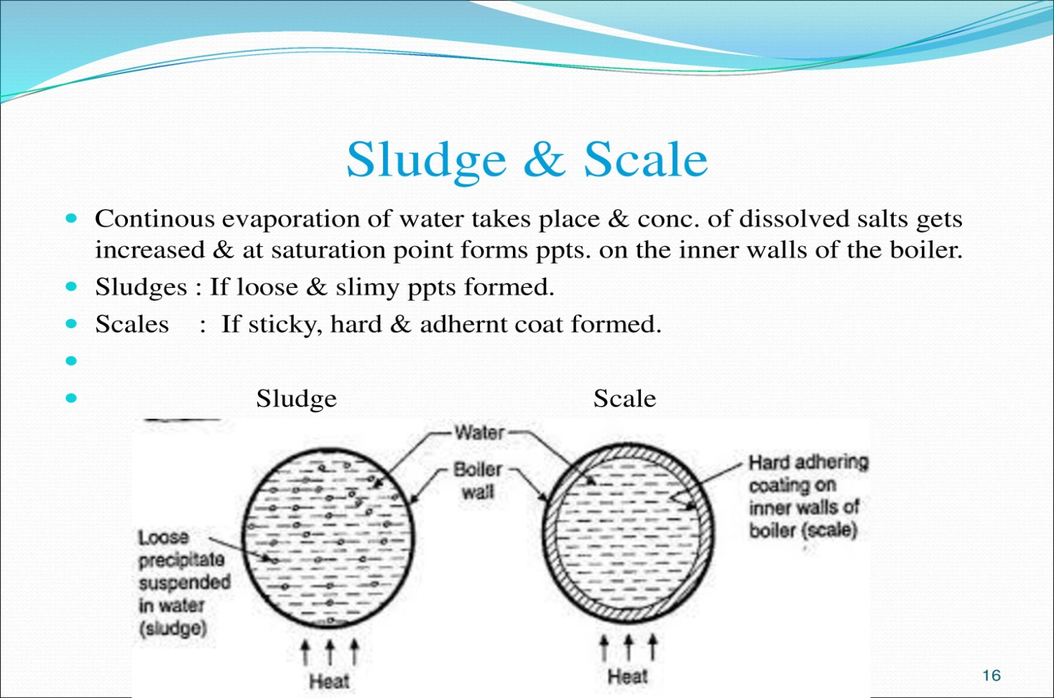
Water Technology
Boiler Troubles
Some of the boiler troubles that arises due to hardness, alkalinity, acidity, gasses and other substances of water.
Formation of scales and sledges: scales are hard materials and sledges are soft materials. Scales and sledges are formed due to the following reasons.

Slide 21
Water Technology
Decomposition of dissolved salts: when hard water contains bicarbonates of Ca & Mg is heated in boiler, they decompose to give insoluble ppts.
Ca (HCO₃)₂ -------- Ca CO₃ + H₂O + CO₂
Mg (HCO₃)₂ -------- Mg Co3 + H₂O + CO₂
Mg CO₃ +H₂O ------ Mg (OH)₂ + CO₂
2. Decrease in the solubility of dissolved salts: The solubility of dissolved salts decreases when the temperature is increased.
3. Hydrolysis of dissolved salts: Some of the DS may under go hydrolysis and ppt. out in the form of scales and sledges.
Mg Cl₂ + H₂O -------- Mg (OH)₂ + HCl
4. Evaporation of boiler – feed water: Due to evaporation of water in the boilers concentration of salts increases and finally ppt. out.
Disadvantages of scales & sledges
Sledges are removed easy but Scales are removed very difficult, during the process boilers ma be damaged.
Scales and sludge are bad conductor of heat, efficiency of boilers are educed.

Slide 22
Water Technology
specifications for drinking water, Bureau of Indian Standards(BIS) and World health organization(WHO) standards
There are certain physical and chemical standards laid down by WHO and USPHS for drinking water.
Physical standards: should be clear, colorless, odorless and pleasant to taste. It should be free from disease producing bacteria and other microscopic matter.
Chemical standards: drinking may contain certain inorganic and organic substances, the amount of these salts should not exceed certain limits.

